Slide 1

DISEASE PREDICTION USING MACHINE LEARNING
MACHINE LEARNING FOR ROBOTICS II
Student:
Durga Varun Gangesetti
S5058219
Supervisor:
Luca Oneto

Slide 2
INTRODUCTION
This project aims to implement a robust machine learning model that can efficiently predict the disease of a human, based on the symptoms that he/she posses.
For doing this, I am using Decision Tree Model, Random Forest Classifier and MLP Classifier.

Slide 3
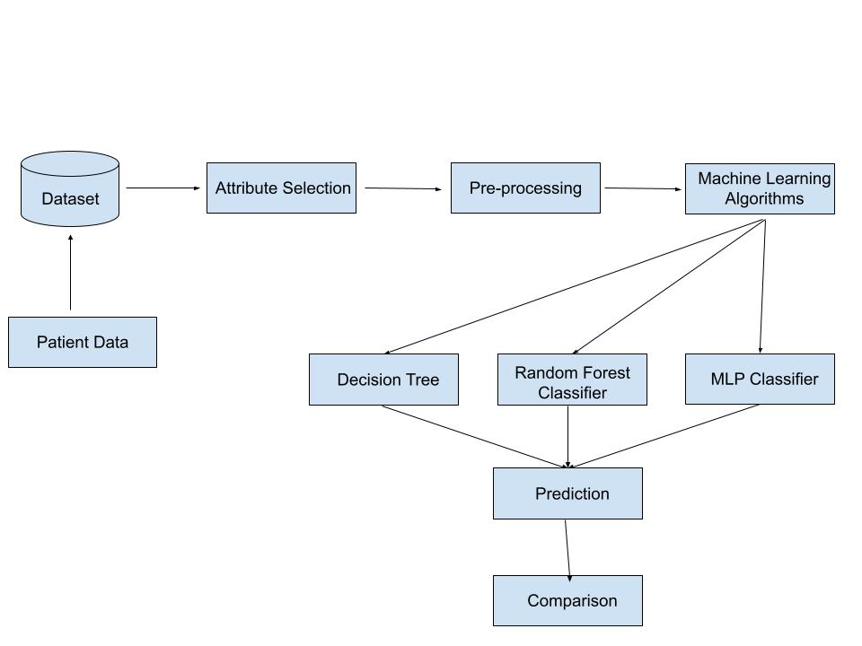
WORKFLOW FOR THE IMPLEMENTATION

Slide 4

APPROACH
Gathering the Data.
Cleaning the Data.
Model Building.
Inference.

Slide 5
APPROACH
Gathering the Data: Data presentation is the primary step for any machine learning problem. I will be using the dataset of two csv files one for training and one for testing.
Cleaning the Date: Cleaning is the most important step in a machine learning project. The quality of the data determines the quality of the machine learning model.
Model Building: After gathering and cleaning the data, the data is ready and can be used to train a machine learning model. I’ll be using this cleaned data to train the Decision tree, MLP classifier and Random Forest Classifier.
Inference: After training the three models, I will be predicting the disease for the input symptoms by using all the three models.

Slide 6
MODEL BUILDING
Decision Tree
Random Forest Classifier
MLP Classifier
I will be using the cleaned data to the models Decision Tree, Random Forest Classifier and MLP Classifier.

Slide 7

Decision Tree
A decision tree is a type of machine learning algorithm that can be used for both classification and regression problems.
It represents a tree-like model of decisions and their possible consequences, modeled in a graph structure. Each node in the tree represents a test on an attribute, and each branch represents the outcome of the test. The leaves represent the final decision or prediction.
Decision trees are simple to understand, interpret and visualize, making them a popular choice for solving problems in many fields.

Slide 8
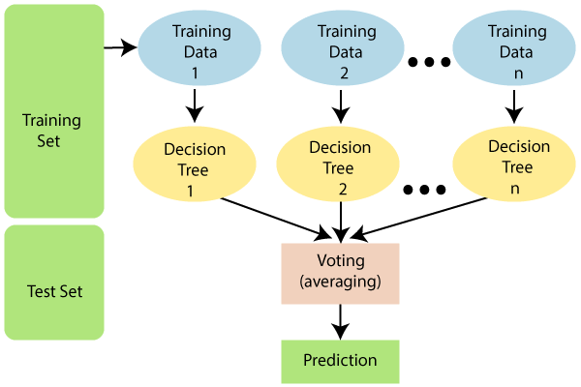
Random Forest Classifier
Random Forest is a popular ensemble learning method for classification and regression tasks that operates by constructing multiple decision trees and combining the predictions made by each tree to improve the overall performance.
The idea behind this method is that the combination of multiple trees can reduce overfitting and improve the generalization of the model.
In a Random Forest classifier, each tree in the forest votes to predict the class of a new data point and the class that receives the most votes becomes the prediction.
The greater number of trees in the forest leads to higher accuracy and prevents the problem of overfitting.

Slide 9
MLP Classifier
MLP stands for Multi-layer Perceptron, which is a type of artificial neural network. It's a supervised learning algorithm that's used for classification tasks. It is often used for complex problems where traditional machine learning algorithms may not perform well.
The MLP classifier is trained on a labeled dataset, where the input data is fed into an input layer, and then processed through one or more hidden layers. The output is then produced by the output layer, which uses a set of weights to make a prediction.
The prediction is compared to the actual label, and the weights are adjusted to reduce the error, this process is repeated multiple times until the error is minimized.

Slide 10
Robot Applications
Healthcare Robot is one of the mostly used applications of these technologies. This algorithm can be integrated to healthcare robots such that they can predict the disease with symptoms provided.

Slide 11
Thank you for your attention

